Slide 1
Empowering Your Research:
A Hands-On Workshop on Statistical Power and Power Analysis
Brett Mercier
Mercier Research
brettgmercier.com

Slide 2
Overview
Theory
  What is power and why does it matter?
  How can you get more power?
  Approaches to sample size planning
Power Analysis Walkthrough
Questions/Discussion

Slide 3
What is Power?
The probability of detecting a true effect
  80% power = 80% chance of correctly detecting a true effect
  When an effect exists, power = the percentage of studies that generate a significant p-value
  Power = 1-B (B = chance of a type two error)
    Power is inversely related B
    Power ranges from 0-1 (probability), or 0-100%
  Question: If there is no true effect, what is the level of statistical power?
    If no effect, chance of correctly detecting an effect is 0, so power is 0

Slide 4
What is Power?
Power is a function of 3 things:
  N (larger n, more power)
  Effect size (larger effect, more power)
  Alpha (higher alpha, more power)
Power, effect size, sample size, alpha
  If you have any 3, you can find the 4th

Slide 5
Why Does Power Matter?
Low statistical power
  Increases the chance of missing a true effect (type 2 error)
  Increases the chance that a finding is a false positive (type 1 error)
    Studies with low power have low positive predictive value (PPV)

Slide 6
Positive Predictive Value
PPV - probability that a ‘positive’ research finding reflects a true effect (that is, the finding is a true positive).
  Depends on
    the prior probability of an effect being true before doing the study
    statistical power of the study
    level of statistical significance

Slide 7
 | Null hypothesis is true (there is no effect) | Alternative hypothesis is true (there is an effect)
Significant finding (p <.05) | Chance of incorrectly identifying a null effect (false positive) | Chance of finding a true positive
Non-significant finding (p <.05) | Chance of not identifying a null effect (True negative) | Chance of missing a real effect (false negative)

Slide 8
 | Null hypothesis is true (there is no effect) | Alternative hypothesis is true (there is an effect)
Significant finding (p <.05) | False Positive = chance of null effect * alpha | True positive = chance effect is real * power
Non-significant finding (p <.05) | True negative = chance of null effect * (1-alpha) | False negative = chance effect is real * (1-power, aka. B)

Slide 9
50% chance of true effect, 80% power
 | Null hypothesis is true (there is no effect) 50% | Alternative hypothesis is true (there is an effect) 50%
Significant finding | False positive 5%*50% = 2.5% | True positive 80%*50% = 40%
Non-significant finding | True negative 95%*50% = 47.5% | False negative 20%*50% = 10%

Slide 10
50% chance of true effect, 80% power
 | Null hypothesis is true (there is no effect) 50% | Alternative hypothesis is true (there is an effect) 50%
Significant finding | False positive 5%*50% = 2.5% | True positive 80%*50% = 40%
2.5/42.5 = 6% of claimed findings are false positives, 94% true positives

Slide 11
50% chance of true effect, 20% power
 | Null hypothesis is true (there is no effect) 50% | Alternative hypothesis is true (there is an effect) 50%
Significant finding | False positive 5%*50% = 2.5% | True positive 20%*50% = 10%
Non-significant finding | True negative 95%*50% = 47.5% | False negative 80%*50% = 40%

Slide 12
50% chance of true effect, 20% power
 | Null hypothesis is true (there is no effect) 50% | Alternative hypothesis is true (there is an effect) 50%
Significant finding | False positive 5%*50% = 2.5% | True positive 20%*50% = 10%
2.5/10 = 25% of claimed findings are false positives, 75% true positives

Slide 13
20% chance of true effect, 20% power
 | Null hypothesis is true (there is no effect) 80% | Alternative hypothesis is true (there is an effect) 20%
Significant finding | False positive 5%*80% = 4% | True positive 20%*20% = 4%
Non-significant finding | True negative 95%*80% = 76% | False negative 80%*20% = 16%

Slide 14
20% chance of true effect, 20% power
 | Null hypothesis is true (there is no effect) 80% | Alternative hypothesis is true (there is an effect) 20%
Significant finding | False positive 5%*80% = 4% | True positive 20%*20% = 4%
4/8 = 50% of claimed findings are false positives, 50% true positives

Slide 15
Shiny app to calculate PPV
http://shinyapps.org/apps/PPV/

Slide 16
Why Does Power Matter?
Low statistical power
  Increases the chance of missing a true effect (type 2 error)
  Increases the chance of a false positive (type 1 error)
  Leads to inflated effect sizes in published research
    When power is low, only large effects reach significance

Slide 17
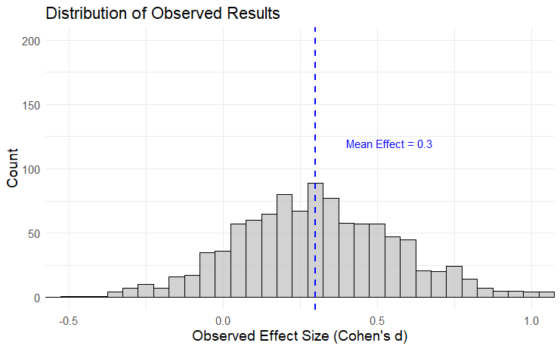
True Effect: d = 0.3, n = 60

Slide 18
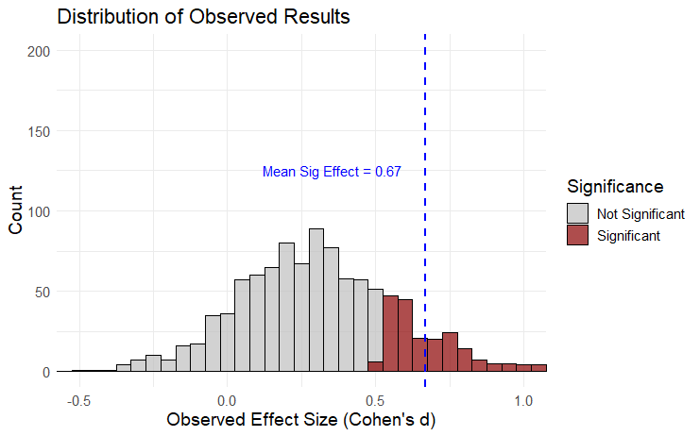
True Effect: d = 0.3, n = 60

Slide 19
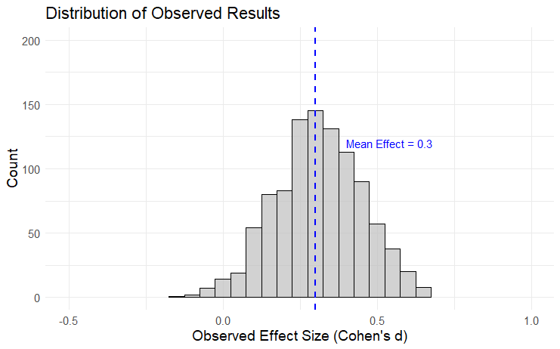
True Effect: d = 0.3, n = 200

Slide 20
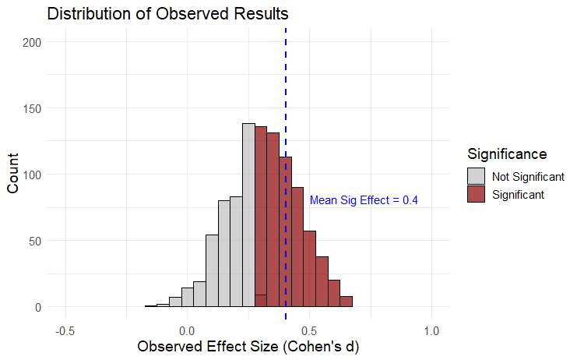
True Effect: d = 0.3, n = 200

Slide 21
Effect Size Inflation Increases Under Low Power
Low Power
Observed effect after publication bias:
d = 0.67
High Power
Observed effect after publication bias:
d = 0.4)

Slide 22

How to get more power?
Increase sample size
Effect size
  Study big effects

Slide 23
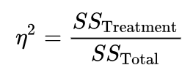
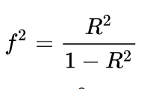
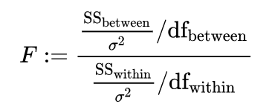
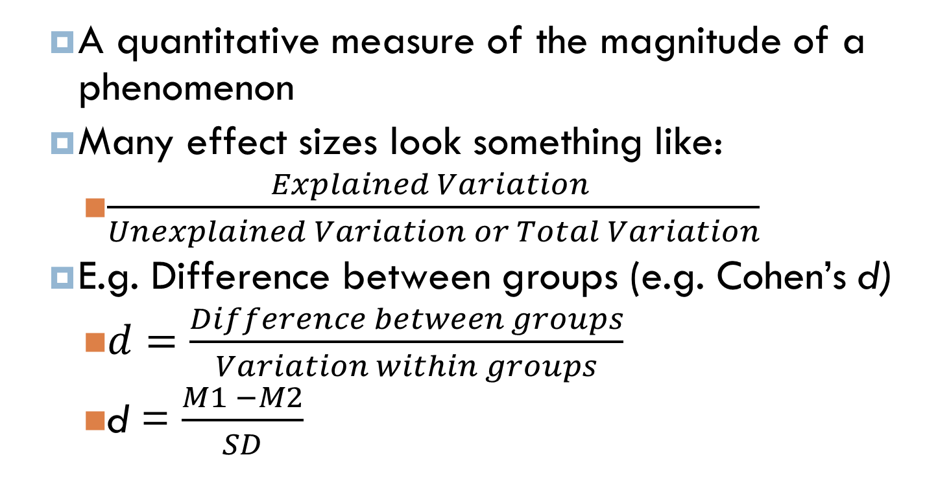
What is an effect size?
  A quantitative measure of the magnitude of a phenomenon
  Many effect sizes look something like:
    $\frac{Explained Variation }{Unexplained Variation or Total Variation}$
  E.g. Difference between groups (e.g. Cohen’s d)
    $d=\frac{Difference between groups}{Variation within groups}$
    d = $\frac{M1 −M2}{SD}$

Slide 24

How to Increase Effect Size
E$ffect size= \frac{Difference between groups}{Variation within groups}$
To increase effect size:
  Increase the difference between the groups
    In experiments, use strong manipulations
  Decrease the random variation within the groups

Slide 25
Decrease the random variation within the groups
Reduce measurement error
  Use a validated, reliable measure
  Multi-item scales generally give more precise measurement than single items
Control for differences between groups
  Should pre-register
  Be careful what you control for (e.g. mediators, proxies; Wysocki et al., 2022)
    Experiments: Measure covariates before manipulation
Use a repeated measures design
  Power calculator: https://shiny.york.ac.uk/powercontours/

Slide 26
How to get more power?
Increase sample size
Increase your effect size
Use direction tests when you have a directional hypothesis.
  Pre-register
  If direction of test is specified before data collection, using one-tailed test increases power and does not increase false positive rate

Slide 27
Power Analyses

Slide 28
Sample Size Determination
A priori power analysis
  Solve for N, given alpha, power, and effect size
  How to determine effect size?
    Past Research?
      Publication bias inflates effect sizes
      Uncertainty around effect sizes
        Fabs package!

Slide 29

Sample Size Determination
Past research found d = 0.7 so the effect is d = 0.7
Past research found d = 0.7 95% CI [0.2, 1.2], so the effect is probably between d = 0.2 and d = 1.2

Slide 30
Sample Size Determination
A priori power analysis
  Solve for N, given alpha, power, and effect size
  How to determine effect size?
    Past Research?
      Publication bias inflates effect sizes
      Uncertainty around effect sizes
        Fabs package!
        Calculates expected statistical power: the proportion of significant results, given the specified sample size and alpha, across the distribution of plausible effect sizes.

Slide 31
Sample Size Determination
A priori power analysis
  Solve for N, given alpha, power, and effect size
  How to determine effect size?
    Past Research?
      Publication bias inflates effect sizes
      Uncertainty around effect sizes
        Fabs package!
    Smallest Effect Size of Interest

Slide 32
Other Types of Power Analyses
Sensitivity: compute ES, given alpha, power, N
  Often conducted following data collection (good way to justify power to reviewers)
    e.g. “given my n, what effect size would I be able to detect 80% of the time?”
    I think this gives the most accurate understand of power after data collection. E.g. What size of effect could I expect to find with this n?

Slide 33
Types of Power Analyses
Post‐hoc: compute power, given alpha, N, ES
Can be useful prior to data collection.
  E.g. “If I get 100 participants’ what power will I have to detect d = 0.2, d = 0.5, and d = 0.7?”
  May tell you whether or not to conduct a study

Slide 34
Types of Power Analyses
Post‐hoc: compute power, given alpha, N, ES
  Sometimes used to calculate “observed power” following data collection
    E.g. “The effect size in my study was X, how much power did I have significantly detect an effect of this size?”

Slide 35
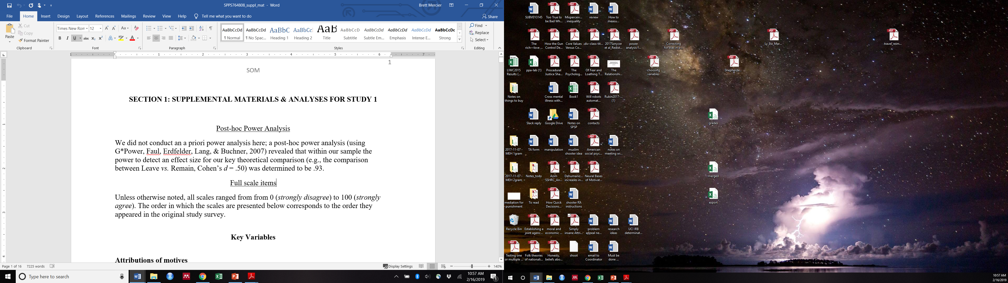
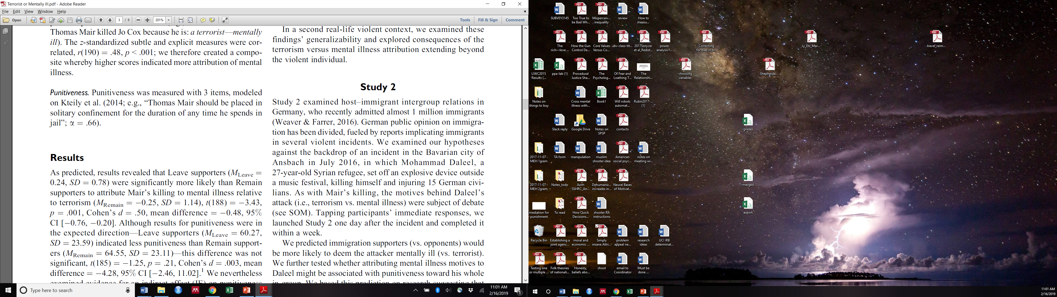
Power hoc Power
Basically just re-reporting the p-value in a different way!

Slide 36
Types of Power Analyses
Post‐hoc: compute power, given alpha, N, ES
  Sometimes used to calculate “observed power” following data collection
    E.g. “The effect size in my study was X, how much power did I have significantly detect an effect of this size?”
    Don’t do this! (see http://daniellakens.blogspot.com/2014/12/observed-power-and-what-to-do-if-your.html)

Slide 37
Alternative Approaches

Slide 38
Sequential Analyses/Optional Stopping
Sequential Analyses: Analysis of data performed at repeated points during data collection
Decide whether to stop or continue data collection based on results
If performed correctly, does not lead to increased false positives!
  Number and timing of analysis points typically need to be specified prior to data collection (pre-register)*
  Need to correct alpha based on number of stopping points to account for repeated testing
    Analogous to correcting for multiple comparisons (in fact, you can use a Bonferroni correction for sequential analyses!)
Some debate about this, see: Lakens, D., Pahlke, F., & Wassmer, G. (2021). Group sequential designs: A tutorial. preprint

Slide 39
Sequential Analyses/Optional Stopping
Example: Researcher wants to examine the data twice, once when half of the data have been collected and once when data collection is finished. She uses a Pocock (1977) adjustment.
  T1 (50% of data collected): alpha = .0294
    After collecting 50% of the data, if p<.0294, the researcher may stop and conclude that there is significant evidence for the hypothesis
  T2 (100% of data collected): alpha = .0294
    If, after collecting all the data, if p< .0294, the researcher can conclude that there is significant evidence for the hypothesis.
    Overall alpha across the whole study is .05
    Compare to Bonferroni (.05/2 = .025 at each analysis point)

Slide 40
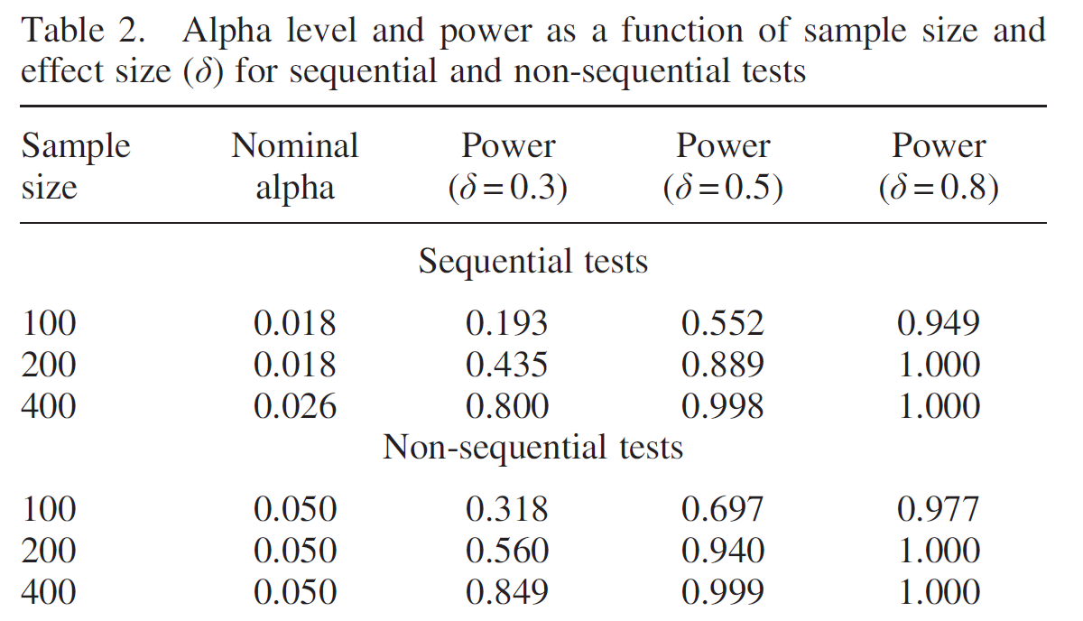
Sequential/Interim Analysis
Lakens, D. (2014). Performing high-powered studies efficiently with sequential analyses. European Journal of Social Psychology, 44, 701–710

Slide 41
Sequential/Interim Analysis
Warning! If you stop early:
  Effect sizes are positively biased
  Confidence intervals around your effect size will be large
Probably best suited for when you are most interested in whether or not an effect exists, rather than when you want to precisely estimate an effect size

Slide 42
Alternative Approaches to Sample Size Planning
Accuracy of parameter estimate
  Determine sample size based on a desired level of accuracy to detect some parameter
  Useful if you aren’t comparing groups (although it can be used when comparing groups as well!)

Slide 43
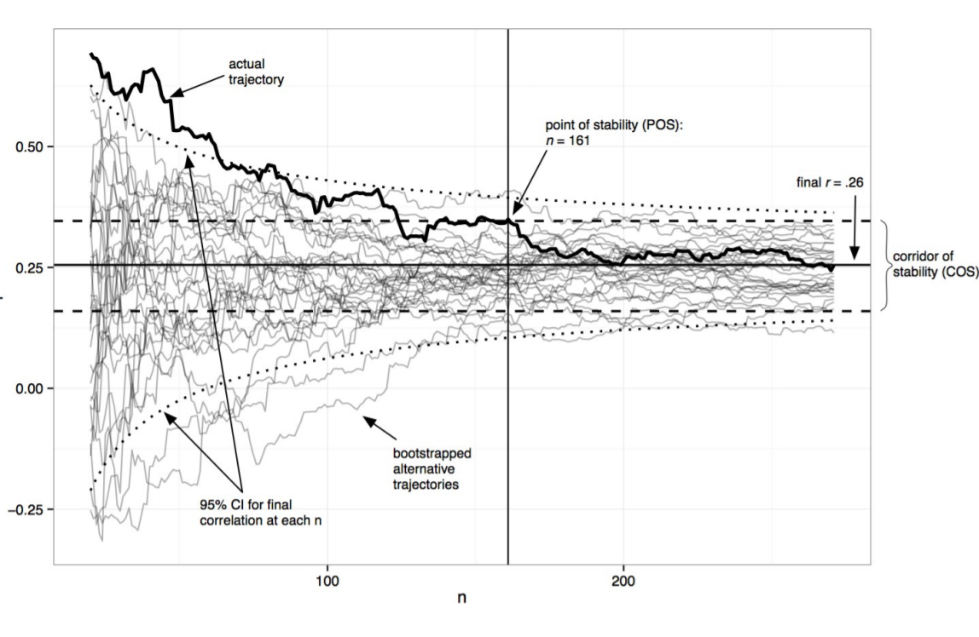

Slide 44
More Complex Cases: SEM
Pilot data can be really useful
Many tools for SEM power, most calculate power for comparison of hypothesized model to null model (e.g. lavaan R package)
Tutorial for calculating power for a specific pathway in an SEM model:
  Wang, Y. A., & Rhemtulla, M. (2021). Power analysis for parameter estimation in structural equation modeling: A discussion and tutorial. Advances in Methods and Practices in Psychological Science, 4(1)

Slide 45
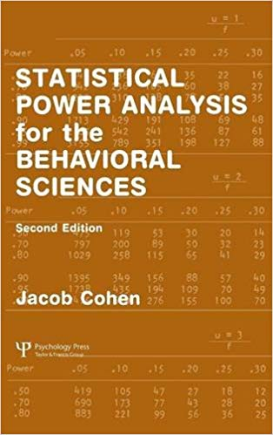
Resources
Lakens, D., & Evers, E. R. (2014). Sailing from the seas of chaos into the corridor of stability: Practical recommendations to increase the informational value of studies. Perspectives on Psychological Science, 9(3), 278-292.
Kenny, D. A., & Judd, C. M. (2017). The Unappreciated Heterogeneity of Effect Sizes: Implications for Power, Precision, Planning of Research, and Replication.
Schönbrodt, F. D., & Perugini, M. (2013). At what sample size do correlations stabilize?. Journal of Research in Personality, 47(5), 609-612.
Baker, D. H., Vilidaite, G., Lygo, F. A., Smith, A. K., Flack, T. R., Gouws, A. D., & Andrews, T. J. (2019). Power contours: optimising sample size and precision in experimental psychology and human neuroscience. arXiv preprint arXiv:1902.06122.
Wysocki, A. C., Lawson, K. M., & Rhemtulla, M. (2022). Statistical control requires causal justification. Advances in Methods and Practices in Psychological Science, 5(2), 25152459221095823.
Saccenti, E., Hendriks, M. H., & Smilde, A. K. (2020). Corruption of the Pearson correlation coefficient by measurement error and its estimation, bias, and correction under different error models. Scientific reports, 10(1), 438.

